Slide 1

CS 584 Machine Learning
Week 11
October 31, 2018

Slide 2

Week 11 Agenda
Define Neural Network
Introduce Perceptron
A Toy Example
Gradient Descent
Backpropagation Algorithm
Chapter 11 of the Machine Learning book

Slide 3
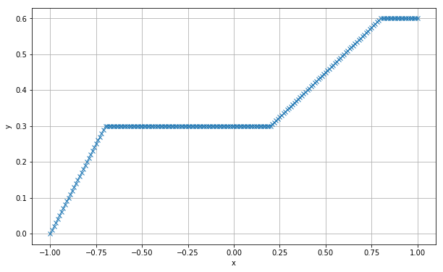
Neural Network Motivation
We observe that there is a relationship between y and x
How will you describe the relationship?
What parametric equations or functions will you use to describe the relationship?

Slide 4
Neural Network Motivation
Since we may not know the true equation, we may need to try a large number of equations
Neural Network uses simple functions as building blocks to assemble (or estimate) the relationship
Often, there are layers of building blocks of functions

Slide 5
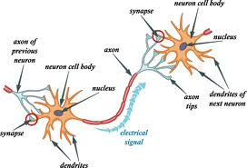
What is a Neural Network?
We should use the proper terminology Artificial Neural Network (ANN) to distinguish ours from the biological neural network
However, ANN borrows the idea from the biological neural network – an interconnected web of neurons transmitting elaborate patterns of electrical signals. Dendrites receive input signals and, based on those inputs, send an output signal via an axon.

Slide 6
Why Do We Still Say Neural Network?
We tend to abbreviate and therefore drop the "A" or the "artificial".
Most of the new models are designed for non-biological applications and users of these new models rarely in the biological field.
However, if you are a data scientist in the biological field, it is better to keep the “A” to avoid any unnecessary confusion.

Slide 7
Define Neural Network
Broadly defined, a neural network is a linkage of many simple processors ("units"), each possibly having a small amount of local transient memory in the form of weights.
The units are connected by directional communication channels ("connections") which transmit numeric data, encoded by any of various means.
The units operate only on their local data and on the inputs they receive via the connections.

Slide 8
Introduce the Perceptron
It is a type of artificial neuron.
It is a single layer neural network.
Perceptron was developed by Frank Rosenblatt in the 1960s.
Principles of Neurodynamics: Perceptrons and the Theory of Brain Mechanisms, Spartan Books, 1962
In the original definition, a perceptron takes several binary inputs and produces a single binary output

Slide 9

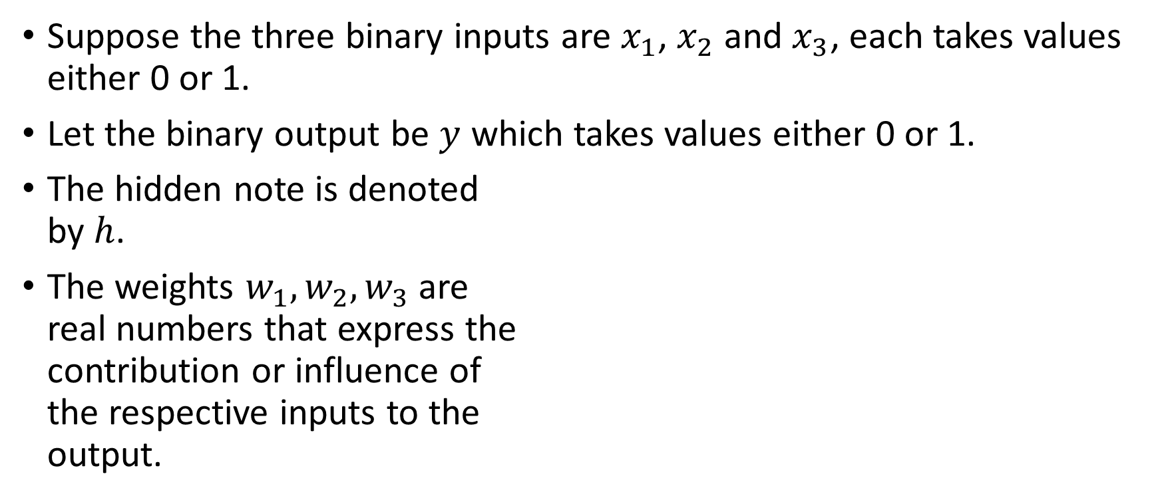







A Representation of a Perceptron
Suppose the three binary inputs are $x_{1}$, $x_{2}$ and $x_{3}$, each takes values either 0 or 1.
Let the binary output be $y$ which takes values either 0 or 1.
The hidden note is denoted by $h$.
The weights $w_{1},w_{2},w_{3}$ are real numbers that express the contribution or influence of the respective inputs to the output.
$$x_{1}$$
$$w_{1}$$
$$x_{2}$$
$$h$$
$$y$$
$$w_{2}$$
$$x_{3}$$
$$w_{3}$$

Slide 10
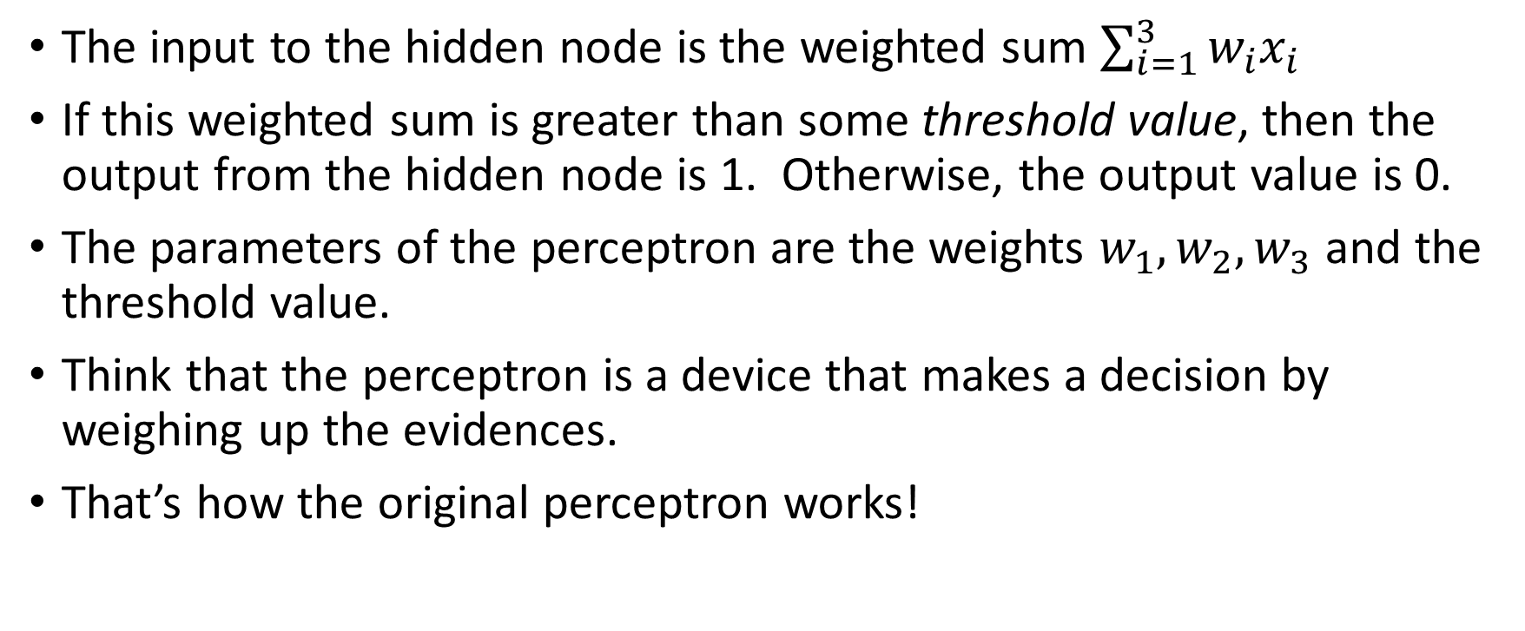
A Representation of a Perceptron
The input to the hidden node is the weighted sum $\sum_{i=1}^{3}{w_{i}x_{i}}$
If this weighted sum is greater than some threshold value, then the output from the hidden node is 1. Otherwise, the output value is 0.
The parameters of the perceptron are the weights $w_{1},w_{2},w_{3}$ and the threshold value.
Think that the perceptron is a device that makes a decision by weighing up the evidences.
That’s how the original perceptron works!

Slide 11
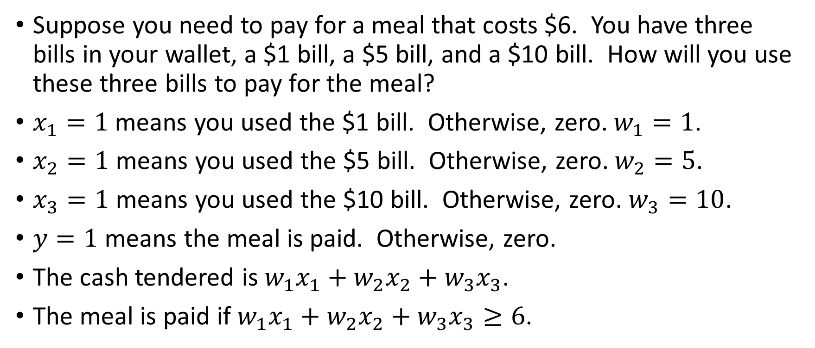
An Example of the Perceptron
Suppose you need to pay for a meal that costs $6. You have three bills in your wallet, a $1 bill, a $5 bill, and a $10 bill. How will you use these three bills to pay for the meal?
$x_{1}=1$ means you used the $1 bill. Otherwise, zero. $w_{1}=1$.
$x_{2}=1$ means you used the $5 bill. Otherwise, zero. $w_{2}=5$.
$x_{3}=1$ means you used the $10 bill. Otherwise, zero. $w_{3}=10$.
$y=1$ means the meal is paid. Otherwise, zero.
The cash tendered is $w_{1}x_{1}+w_{2}x_{2}+w_{3}x_{3}$.
The meal is paid if $w_{1}x_{1}+w_{2}x_{2}+w_{3}x_{3}≥6$.

Slide 12
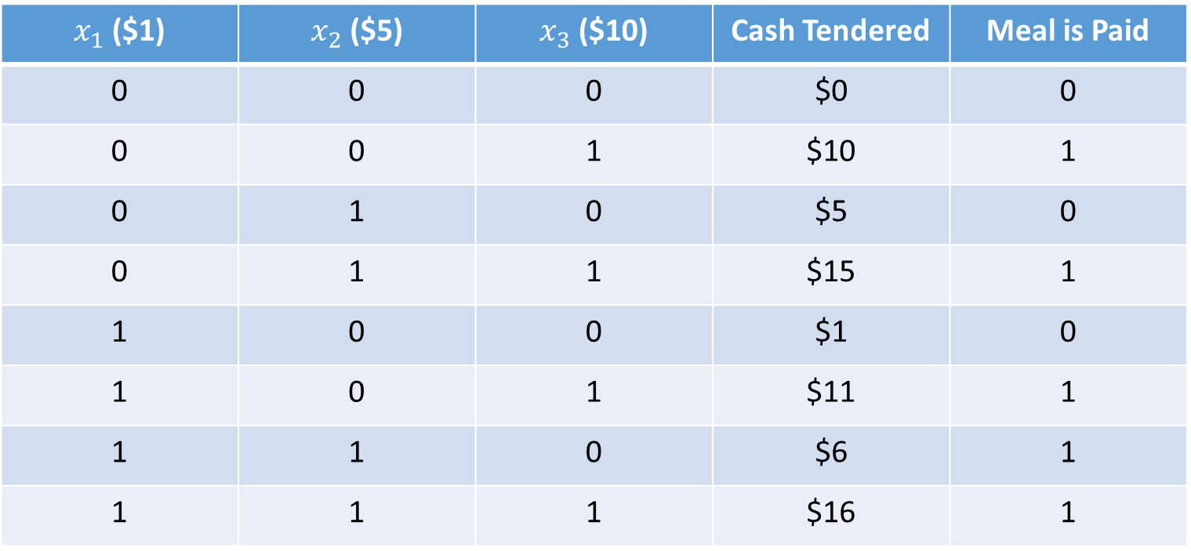
An Example of the Perceptron
$x_{1}$ ($1) | $x_{2}$ ($5) | $x_{3}$ ($10) | Cash Tendered | Meal is Paid
0 | 0 | 0 | $0 | 0
0 | 0 | 1 | $10 | 1
0 | 1 | 0 | $5 | 0
0 | 1 | 1 | $15 | 1
1 | 0 | 0 | $1 | 0
1 | 0 | 1 | $11 | 1
1 | 1 | 0 | $6 | 1
1 | 1 | 1 | $16 | 1

Slide 13
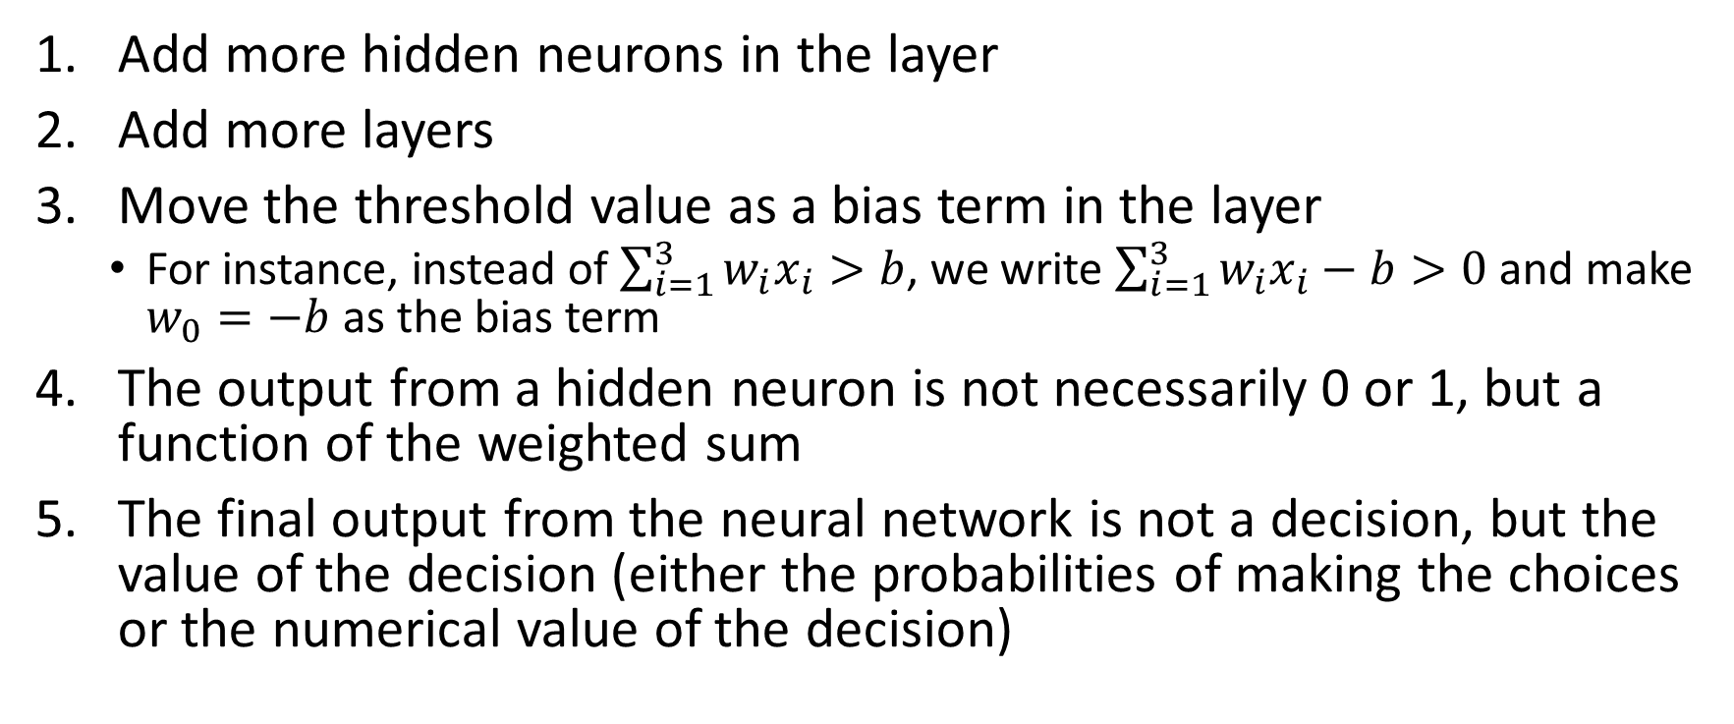
Extend and Expand the Perceptron
Add more hidden neurons in the layer
Add more layers
Move the threshold value as a bias term in the layer
For instance, instead of $\sum_{i=1}^{3}{w_{i}x_{i}>b}$, we write $\sum_{i=1}^{3}{w_{i}x_{i}}−b>0$ and make $w_{0}=−b$ as the bias term
The output from a hidden neuron is not necessarily 0 or 1, but a function of the weighted sum
The final output from the neural network is not a decision, but the value of the decision (either the probabilities of making the choices or the numerical value of the decision)

Slide 14
Introduce the Multi-Layer Perceptron
Bias
Y1
H(2:0)
H(1:0)
H(3:0)
X1
H(2:1)
Y2
X2
H(1:1)
H(3:1)
H(2:2)
Y3
X3
Input Layer
Hidden Layer
Output Layer

Slide 15
Structure of a Multi-Layer Perceptron (MLP)
The units are entities in the neural network diagram.
The input layer contains the input variables and the optional bias term.
Create a dummy coding unit (i.e., 0 and 1) for each category of the input variable.
The hidden layer contains unobservable units.
The value of each hidden unit is the resulting value of the activation function of the preceding units that feed into the hidden unit.
The combination function determines how information from preceding units are combined.
The output layer contains the target variables.
Create a dummy coding unit (i.e., 0 and 1) for each category of the output variable.

Slide 16
Structure of a Multi-Layer Perceptron (MLP)
The bias unit indicates the baseline input into the succeeding units. It is like the intercept term in regression.
The weights are numeric values that indicate the strength of the signal from a preceding unit to a succeeding unit.
The combination function combines weights and values of preceding units into a single value that feed into the activation function.
The activation function transforms result of combination function into the value for the succeeding unit.

Slide 17
Structure of a Multi-Layer Perceptron (MLP)
The error function measures the discrepancy between the network output values and the observed target values.
The objective function is what you directly try to optimize in building the network.

Slide 18
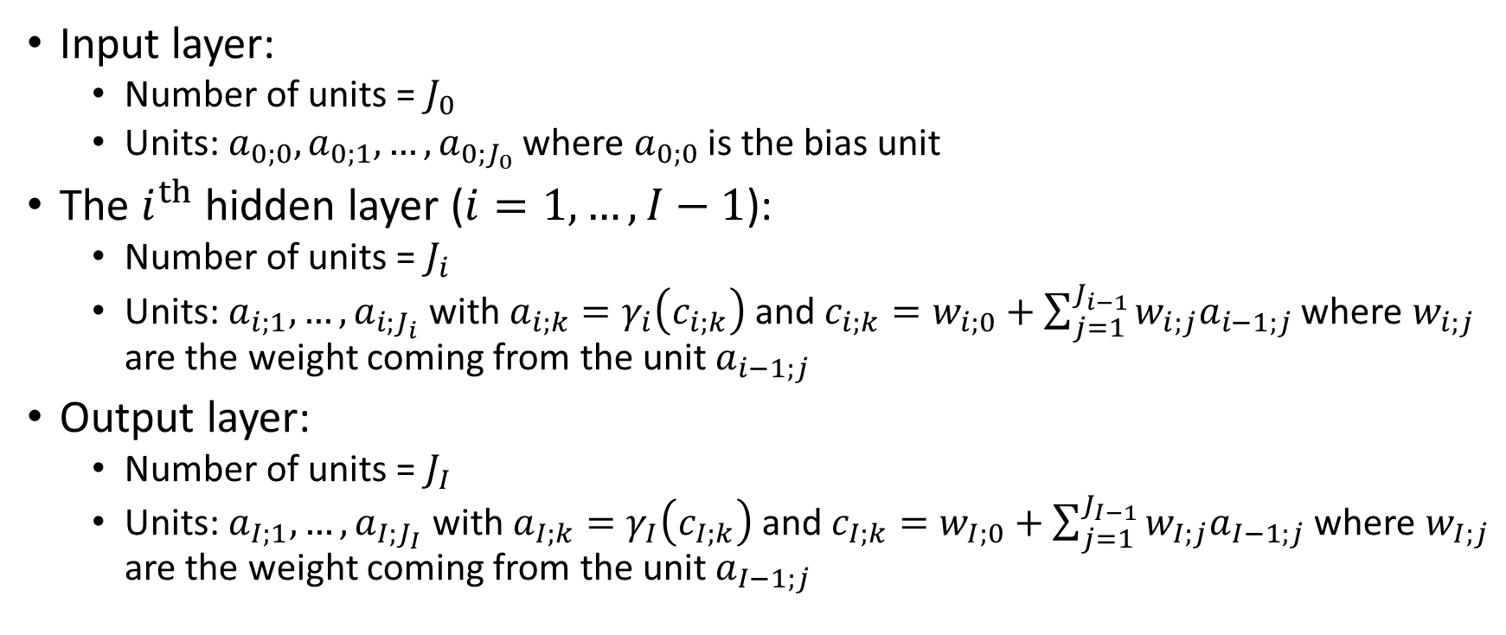
The MLP Mathematical Representation
Input layer:
Number of units = $J_{0}$
Units: ${a_{0;0},a}_{0;1},…,a_{0;J_{0}}$ where $a_{0;0}$ is the bias unit
The $i^{th}$hidden layer ($i=1,…,I−1$):
Number of units = $J_{i}$
Units: $a_{i;1},…,a_{i;J_{i}}$ with $a_{i;k}=γ_{i}\left(c_{i;k}\right)$ and $c_{i;k}=w_{i;0}+\sum_{j=1}^{J_{i−1}}{w_{i;j}a_{i−1;j}}$ where $w_{i;j}$ are the weight coming from the unit $a_{i−1;j}$
Output layer:
Number of units = $J_{I}$
Units: $a_{I;1},…,a_{I;J_{I}}$ with $a_{I;k}=γ_{I}\left(c_{I;k}\right)$ and $c_{I;k}=w_{I;0}+\sum_{j=1}^{J_{I−1}}{w_{I;j}a_{I−1;j}}$ where $w_{I;j}$ are the weight coming from the unit $a_{I−1;j}$

Slide 19
The MLP Mathematical Representation
The combination function is the inner product (i.e., the dot product) of the weights and the values of preceding units.
The bias term is not counted in the total number of units of a layer.
When there is no hidden layer (i.e., I = 1), the MLP becomes a generalized linear model where linear regression is a special case.

Slide 20

Activation Functions for Hidden Layer
Hyperbolic Tangent
$γ\left(c\right)=tanh\left(c\right)$ $=\frac{\exp\left(c\right)−exp⁡\left(−c\right)}{\exp\left(c\right)+exp⁡\left(−c\right)}$
Logistic
$γ\left(c\right)=\frac{1}{1+exp\left(−c\right)}$

Slide 21
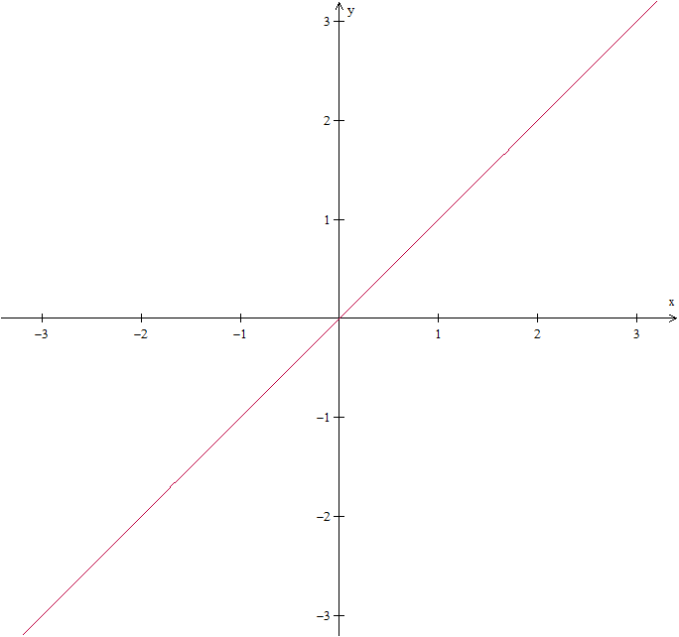
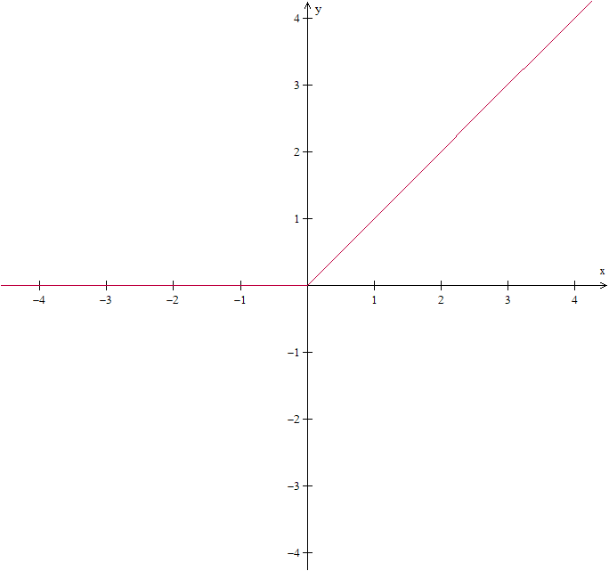

Activation Functions for Hidden Layer
Identity
$γ\left(c\right)=c$
RELU
$γ\left(c\right)=max⁡(0,c)$

Slide 22
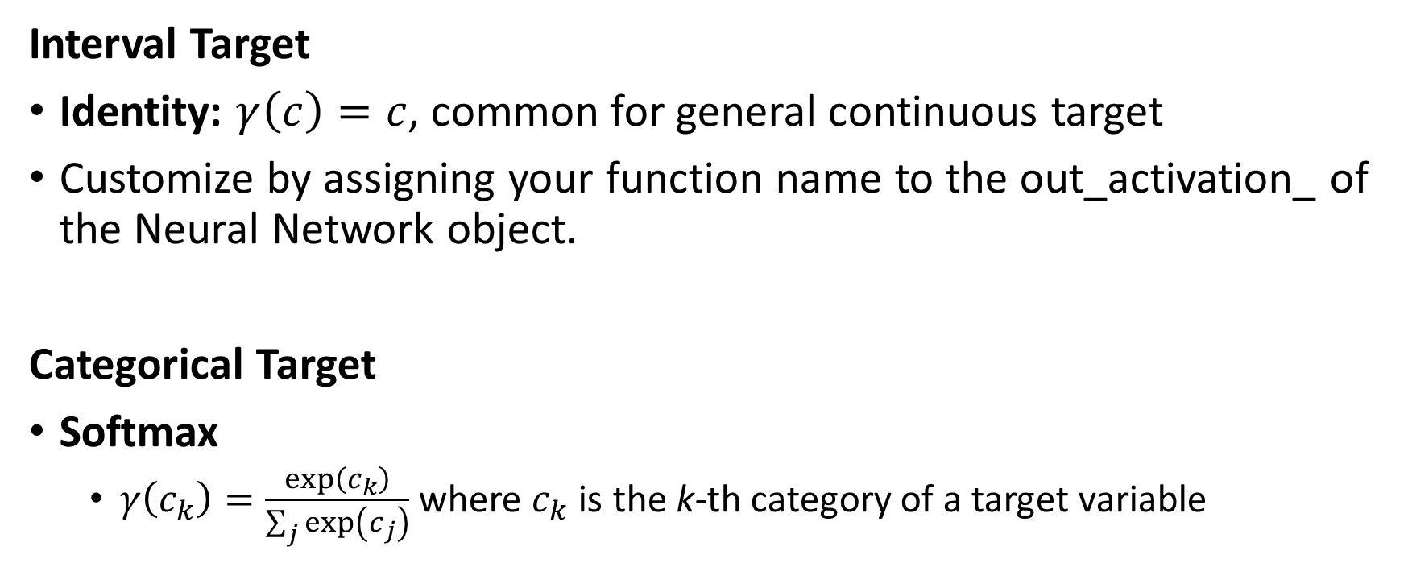
Activation Functions for Output Layer
Interval Target
Identity: $γ\left(c\right)=c$, common for general continuous target
Customize by assigning your function name to the out_activation_ of the Neural Network object.
Categorical Target
Softmax
$γ\left(c_{k}\right)=\frac{exp⁡\left(c_{k}\right)}{\sum_{j}{exp⁡\left(c_{j}\right)}}$ where $c_{k}$ is the k-th category of a target variable

Slide 23
Scaling of input variables
In order to avoid numerical problems in estimation due to differences in magnitudes of input variables, the input variables are usually rescaled before using them in a neural network.
Common methods:
Mid-range – scaled such that the midpoint is 0, the minimum is -1 and the maximum of 1. Formula: y = ((x – x_{min}) – (x_{max} – x))/(x_{max} – x_{min})
Range – scaled such that the minimum is 0 and the maximum is 1. Formula: y = (x – x_{min})/(x_{max} – x_{min})
Standard Deviation – scaled such that the mean is 0 and the standard deviation is 1. Formula: y = (x – x_{mean}) / x_{std}

Slide 24
Scaling of input variables
Categorical input: no scaling is necessary because the values of dummy variables are either 0 or 1.
Interval input:
Use Mid-range or range if the input values are bounded (e.g., age, height)
Use standard deviation for general interval inputs

Slide 25
Back to Our Toy Example
We will conduct a small experiment to see if the accuracy will increase with more layers and more hidden neurons
Scenarios:
1 Hidden Layer, 5 Neurons
1 Hidden Layer, 10 Neurons
2 Hidden Layers, 5 Neurons each
2 Hidden Layers, 10 Neurons each
3 Hidden Layers, 5 Neurons
3 Hidden Layers, 10 Neurons each

Slide 26
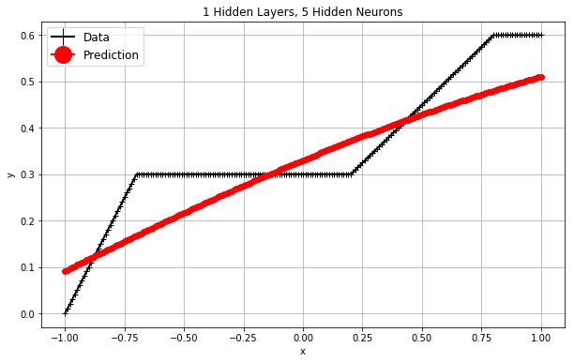
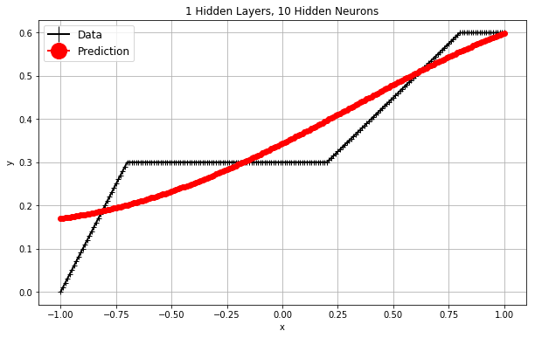
Back to Our Toy Example
Iteration 127, loss = 0.00241875
R^2 = 0.7635
Iteration 24, loss = 0.00173998
R^2 = 0.8280

Slide 27
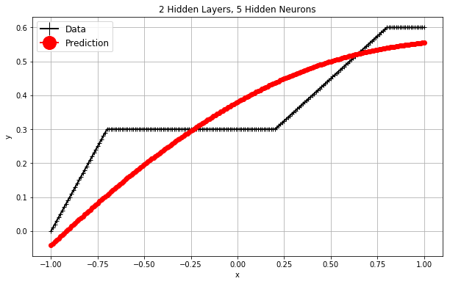
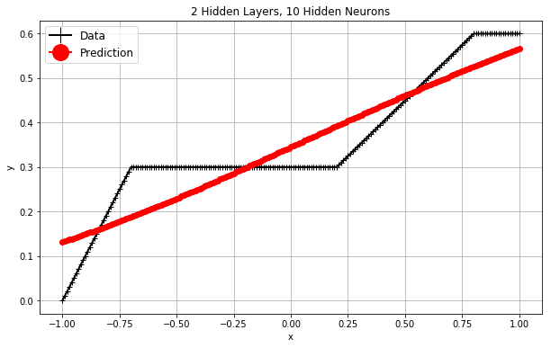
Back to Our Toy Example
Iteration 138, loss = 0.00424793
R^2 = 0.5816
Iteration 45, loss = 0.00175207
R^2 = 0.8266

Slide 28
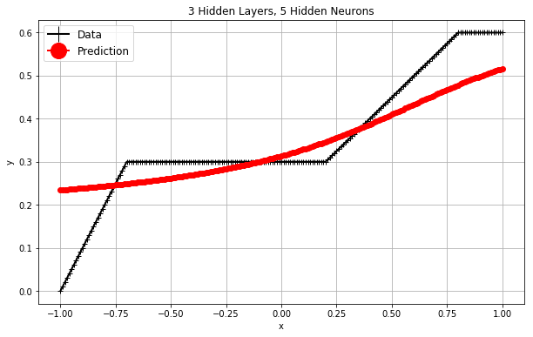
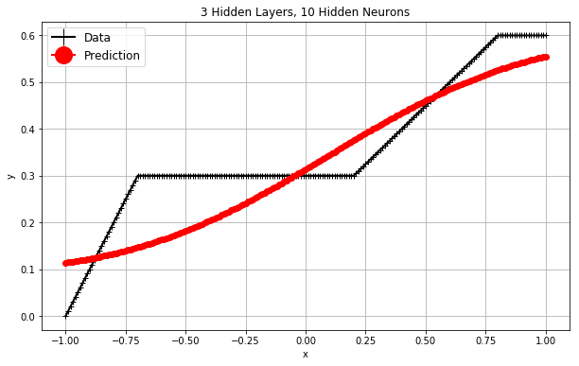
Back to Our Toy Example
Iteration 38, loss = 0.00255299
R^2 = 0.7515
Iteration 27, loss = 0.00323979
R^2 = 0.7431

Slide 29
Back to Our Toy Example
N Layer | N Hidden Nodes | Iteration | Loss | R^2
1 | 5 | 127 | 0.00241875 | 0.7635
1 | 10 | 24 | 0.00173998 | 0.8280
2 | 5 | 138 | 0.00424793 | 0.5816
2 | 10 | 45 | 0.00175207 | 0.8266
3 | 5 | 38 | 0.00255299 | 0.7515
3 | 10 | 27 | 0.00323979 | 0.7431
N Layer | N Hidden Nodes | Iteration | Loss | R^2
1 | 5 | 127 | 0.00241875 | 0.7635
2 | 5 | 138 | 0.00424793 | 0.5816
3 | 5 | 38 | 0.00255299 | 0.7515
1 | 10 | 24 | 0.00173998 | 0.8280
2 | 10 | 45 | 0.00175207 | 0.8266
3 | 10 | 27 | 0.00323979 | 0.7431
Preliminary Findings
More hidden nodes per layer may yield lower loss and higher R^2
More hidden layers may not yield better results
Conclusion
It is a trial-and-error process to find the right scenario of the number of layers, the number of hidden nodes, and the activation function

Slide 30
Estimating the Parameters
Input layer:
Number of units = $J_{0}$
Units: ${a_{0;0},a}_{0;1},…,a_{0;J_{0}}$ where $a_{0;0}$ is the bias unit
The $i^{th}$hidden layer ($i=1,…,I−1$):
Number of units = $J_{i}$
Units: $a_{i;1},…,a_{i;J_{i}}$ with $a_{i;k}=γ_{i}\left(c_{i;k}\right)$ and $c_{i;k}=w_{i;0}+\sum_{j=1}^{J_{i−1}}{w_{i;j}a_{i−1;j}}$ where $w_{i;j}$ are the weight coming from the unit $a_{i−1;j}$
Output layer:
Number of units = $J_{I}$
Units: $a_{I;1},…,a_{I;J_{I}}$ with $a_{I;k}=γ_{I}\left(c_{I;k}\right)$ and $c_{I;k}=w_{I;0}+\sum_{j=1}^{J_{I−1}}{w_{I;j}a_{I−1;j}}$ where $w_{I;j}$ are the weight coming from the unit $a_{I−1;j}$

Slide 31
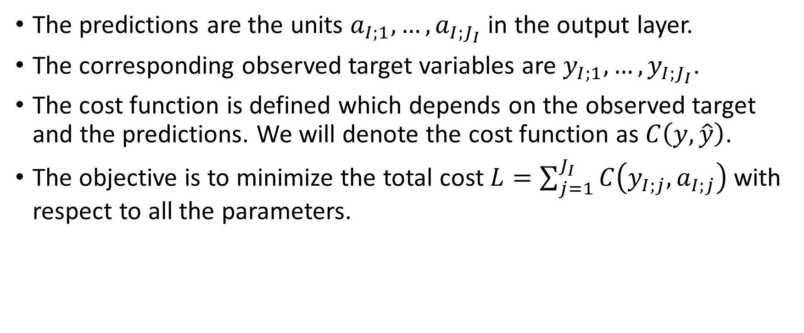
The Cost Function
The predictions are the units $a_{I;1},…,a_{I;J_{I}}$ in the output layer.
The corresponding observed target variables are $y_{I;1},…,y_{I;J_{I}}$.
The cost function is defined which depends on the observed target and the predictions. We will denote the cost function as $C\left(y,\hat{y}\right)$.
The objective is to minimize the total cost $L=\sum_{j=1}^{J_{I}}{C\left(y_{I;j},a_{I;j}\right)}$ with respect to all the parameters.

Slide 32
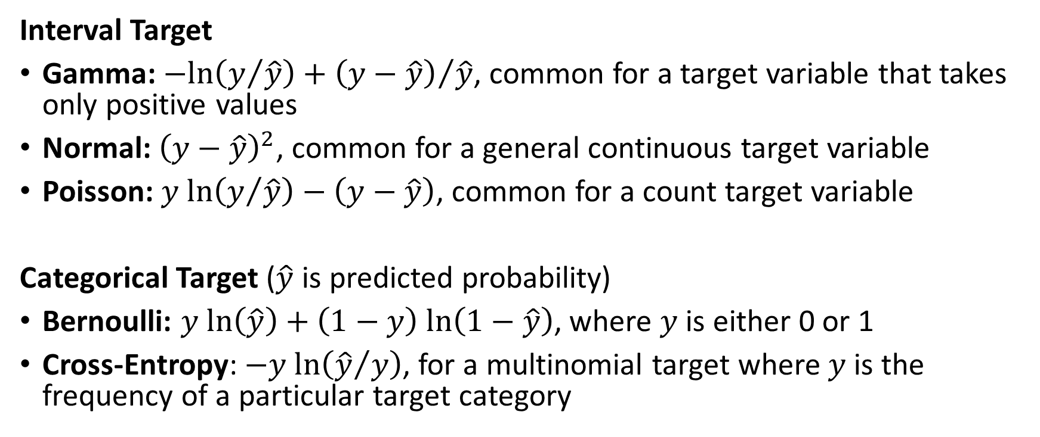
Common Cost Function
Interval Target
Gamma: $−ln\left(y/{\hat{y}}\right)+{\left(y−\hat{y}\right)}/{\hat{y}}$, common for a target variable that takes only positive values
Normal: ${\left(y−\hat{y}\right)}^{2}$, common for a general continuous target variable
Poisson: $y ln\left(y/{\hat{y}}\right)−\left(y−\hat{y}\right)$, common for a count target variable
Categorical Target ($\hat{y}$ is predicted probability)
Bernoulli: $y ln\left(\hat{y}\right)+\left(1−y\right) ln\left(1−\hat{y}\right)$, where $y$ is either 0 or 1
Cross-Entropy: $−y ln\left({\hat{y}}/y\right)$, for a multinomial target where $y$ is the frequency of a particular target category

Slide 33

Minimize the Total Cost Function
Denote $w=\left(w_{i;j}\right)$ as the vector of all parameters.
Our task is to minimize the total cost $L≡L\left(w\right)$ with respect to $w$.
The necessary condition for the $L\left(w\right)$ attains its minimum at $w=\hat{w}$ is that $∇L\left(\hat{w}\right)=0$ where $∇L$is the gradient of the total cost function.

Slide 34
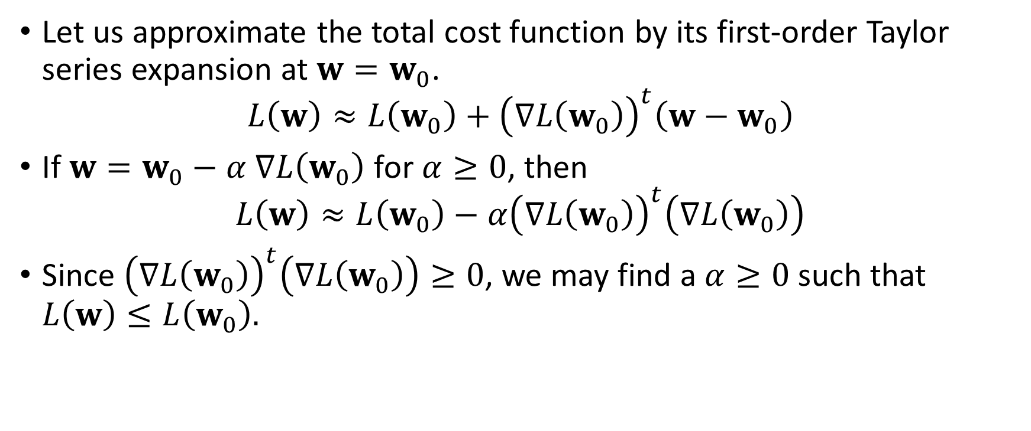
The Gradient Descent Method
Let us approximate the total cost function by its first-order Taylor series expansion at $w=w_{0}$.
$$L\left(w\right)≈L\left(w_{0}\right)+{\left(∇L\left(w_{0}\right)\right)}^{t}\left(w−w_{0}\right)$$
If $w=w_{0}−α$ $∇L\left(w_{0}\right)$ for $α≥0$, then
$$L\left(w\right)≈L\left(w_{0}\right)−α{\left(∇L\left(w_{0}\right)\right)}^{t}\left(∇L\left(w_{0}\right)\right)$$
Since ${\left(∇L\left(w_{0}\right)\right)}^{t}\left(∇L\left(w_{0}\right)\right)≥0$, we may find a $α≥0$ such that $L\left(w\right)≤L\left(w_{0}\right).$

Slide 35
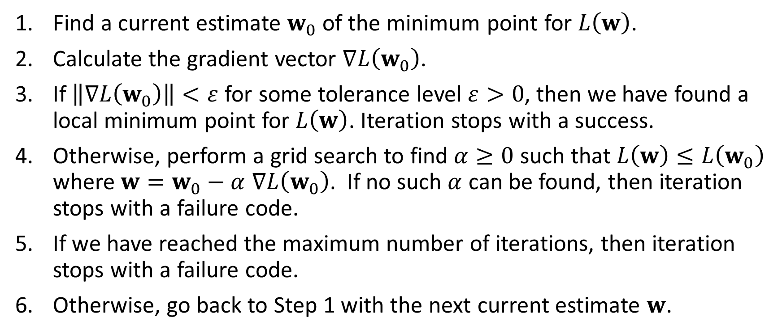
The Gradient Descent Method
Find a current estimate $w_{0}$of the minimum point for $L\left(w\right)$.
Calculate the gradient vector $∇L\left(w_{0}\right)$.
If $\left\|∇L\left(w_{0}\right)\right\|<ε$ for some tolerance level $ε>0$, then we have found a local minimum point for $L\left(w\right)$. Iteration stops with a success.
Otherwise, perform a grid search to find $α≥0$ such that $L\left(w\right)≤L\left(w_{0}\right)$ where $w=w_{0}−α$ $∇L\left(w_{0}\right)$. If no such $α$ can be found, then iteration stops with a failure code.
If we have reached the maximum number of iterations, then iteration stops with a failure code.
Otherwise, go back to Step 1 with the next current estimate $w$.

Slide 36
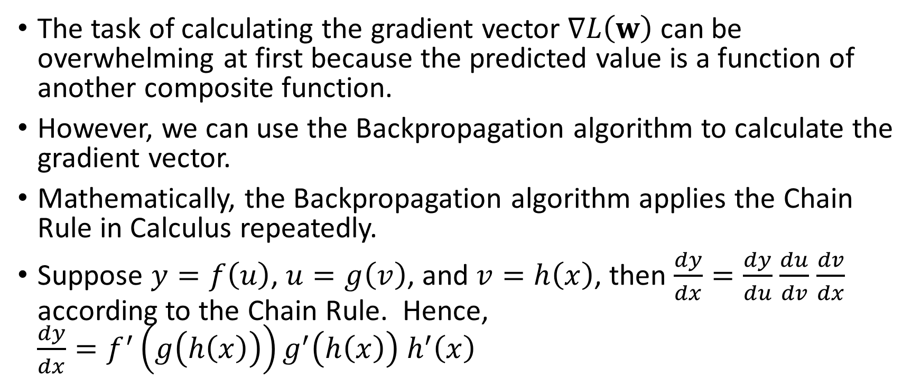
Calculating the Gradient Vector
The task of calculating the gradient vector $∇L\left(w\right)$ can be overwhelming at first because the predicted value is a function of another composite function.
However, we can use the Backpropagation algorithm to calculate the gradient vector.
Mathematically, the Backpropagation algorithm applies the Chain Rule in Calculus repeatedly.
Suppose $y=f\left(u\right)$, $u=g\left(v\right)$, and $v=h\left(x\right)$, then $\frac{dy}{dx}=\frac{dy}{du}$ $\frac{du}{dv}$ $\frac{dv}{dx}$ according to the Chain Rule. Hence, $\frac{dy}{dx}=f^{′}\left(g\left(h\left(x\right)\right)\right)g^{′}\left(h\left(x\right)\right)$ $h^{′}\left(x\right)$

Slide 37
Illustration Using this Neural Network
Bias
Y1
H(2:0)
H(1:0)
H(3:0)
X1
H(2:1)
Y2
X2
H(1:1)
H(3:1)
H(2:2)
Y3
X3
Input Layer
Hidden Layer
Output Layer

Slide 38
Backpropagation Algorithm Illustration
X₀
y₁
h₂₀
h₁₀
h₃₀
x₁
h₂₁
y₂
x₂
h₁₁
h₃₁
h₂₂
y₃
x₃
Input Layer
Hidden Layer
Output Layer

Slide 39
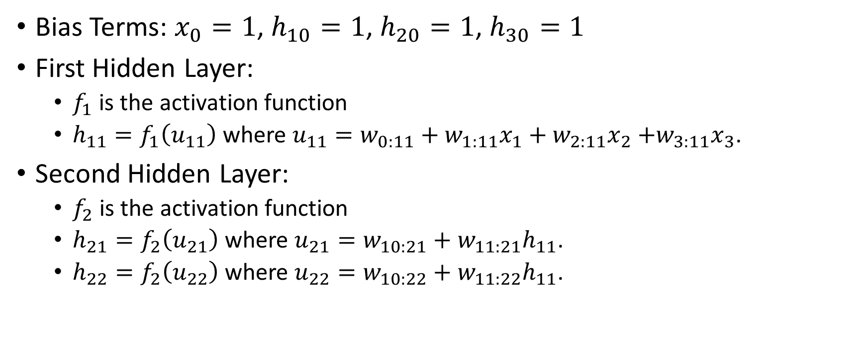
Backpropagation Algorithm Illustration
Bias Terms: $x_{0}=1$, $h_{10}=1$, $h_{20}=1$, $h_{30}=1$
First Hidden Layer:
$f_{1}$ is the activation function
$h_{11}=f_{1}\left(u_{11}\right)$ where $u_{11}=w_{0:11}+w_{1:11}x_{1}+w_{2:11}x_{2}$ $+w_{3:11}x_{3}$.
Second Hidden Layer:
$f_{2}$ is the activation function
$h_{21}=f_{2}\left(u_{21}\right)$ where $u_{21}=w_{10:21}+w_{11:21}h_{11}$.
$h_{22}=f_{2}\left(u_{22}\right)$ where $u_{22}=w_{10:22}+w_{11:22}h_{11}$.

Slide 40
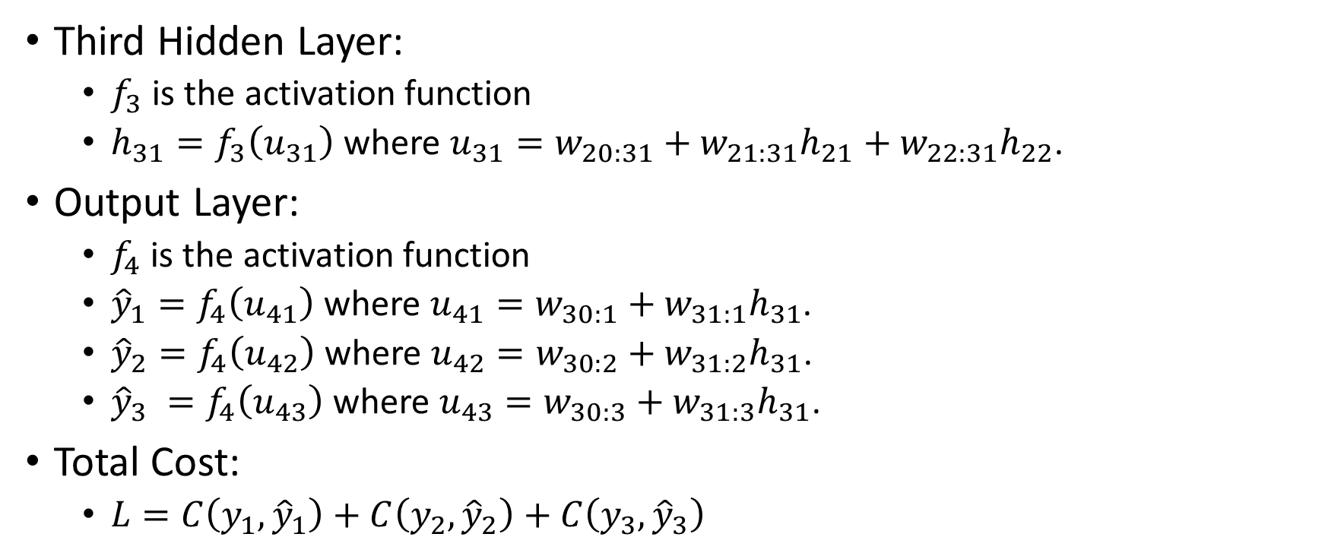
Backpropagation Algorithm Illustration
Third Hidden Layer:
$f_{3}$ is the activation function
$h_{31}=f_{3}\left(u_{31}\right)$ where $u_{31}=w_{20:31}+w_{21:31}h_{21}+w_{22:31}h_{22}$.
Output Layer:
$f_{4}$ is the activation function
${\hat{y}}_{1}=f_{4}\left(u_{41}\right)$ where $u_{41}=w_{30:1}+w_{31:1}h_{31}$.
${\hat{y}}_{2}=f_{4}\left(u_{42}\right)$ where $u_{42}=w_{30:2}+w_{31:2}h_{31}$.
${\hat{y}}_{3} =f_{4}\left(u_{43}\right)$ where $u_{43}=w_{30:3}+w_{31:3}h_{31}$.
Total Cost:
$L=C\left(y_{1},{\hat{y}}_{1}\right)+C\left(y_{2},{\hat{y}}_{2}\right)+C\left(y_{3},{\hat{y}}_{3}\right)$

Slide 41
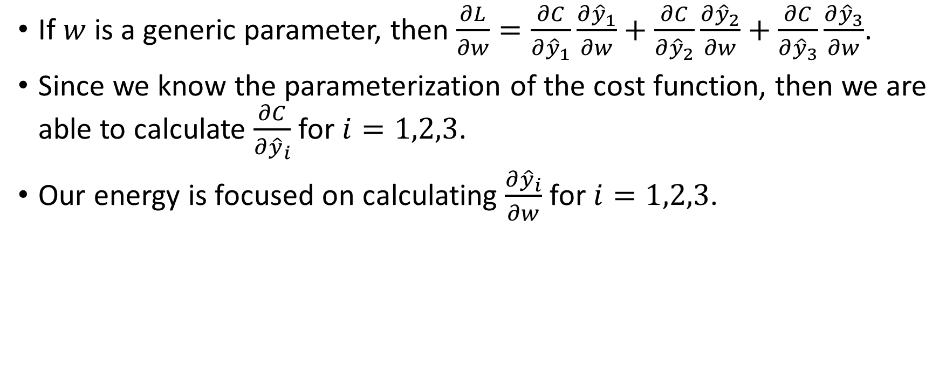
Backpropagation Algorithm Illustration
If $w$ is a generic parameter, then $\frac{∂L}{∂w}=\frac{∂C}{∂{\hat{y}}_{1}}\frac{∂{\hat{y}}_{1}}{∂w}+\frac{∂C}{∂{\hat{y}}_{2}}\frac{∂{\hat{y}}_{2}}{∂w}+\frac{∂C}{∂{\hat{y}}_{3}}\frac{∂{\hat{y}}_{3}}{∂w}$.
Since we know the parameterization of the cost function, then we are able to calculate $\frac{∂C}{∂{\hat{y}}_{i}}$ for $i=1,2,3$.
Our energy is focused on calculating $\frac{∂{\hat{y}}_{i}}{∂w}$ for $i=1,2,3$.

Slide 42
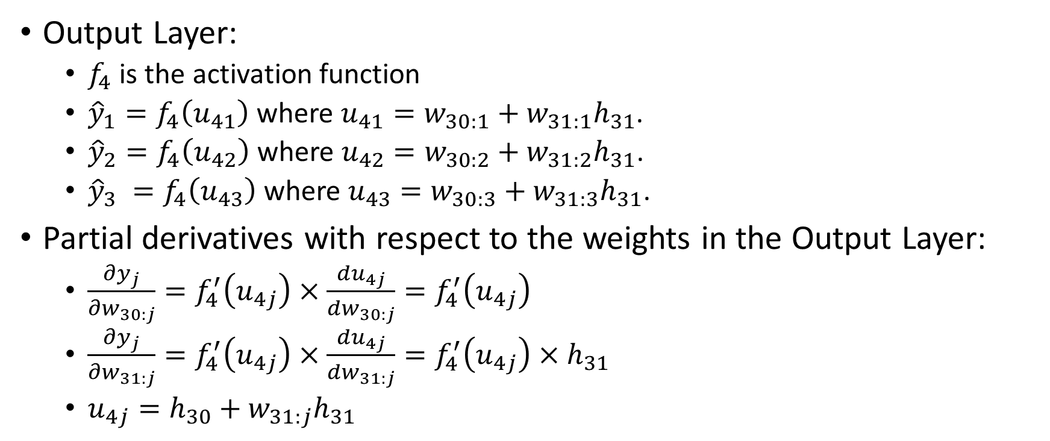
Backpropagation Algorithm Illustration
Output Layer:
$f_{4}$ is the activation function
${\hat{y}}_{1}=f_{4}\left(u_{41}\right)$ where $u_{41}=w_{30:1}+w_{31:1}h_{31}$.
${\hat{y}}_{2}=f_{4}\left(u_{42}\right)$ where $u_{42}=w_{30:2}+w_{31:2}h_{31}$.
${\hat{y}}_{3} =f_{4}\left(u_{43}\right)$ where $u_{43}=w_{30:3}+w_{31:3}h_{31}$.
Partial derivatives with respect to the weights in the Output Layer:
$\frac{∂y_{j}}{∂w_{30:j}}=f_{4}^{′}\left(u_{4j}\right)×\frac{du_{4j}}{dw_{30:j}}=f_{4}^{′}\left(u_{4j}\right)$
$\frac{∂y_{j}}{∂w_{31:j}}=f_{4}^{′}\left(u_{4j}\right)×\frac{du_{4j}}{dw_{31:j}}=f_{4}^{′}\left(u_{4j}\right)×h_{31}$
$u_{4j}=h_{30}+w_{31:j}h_{31}$

Slide 43
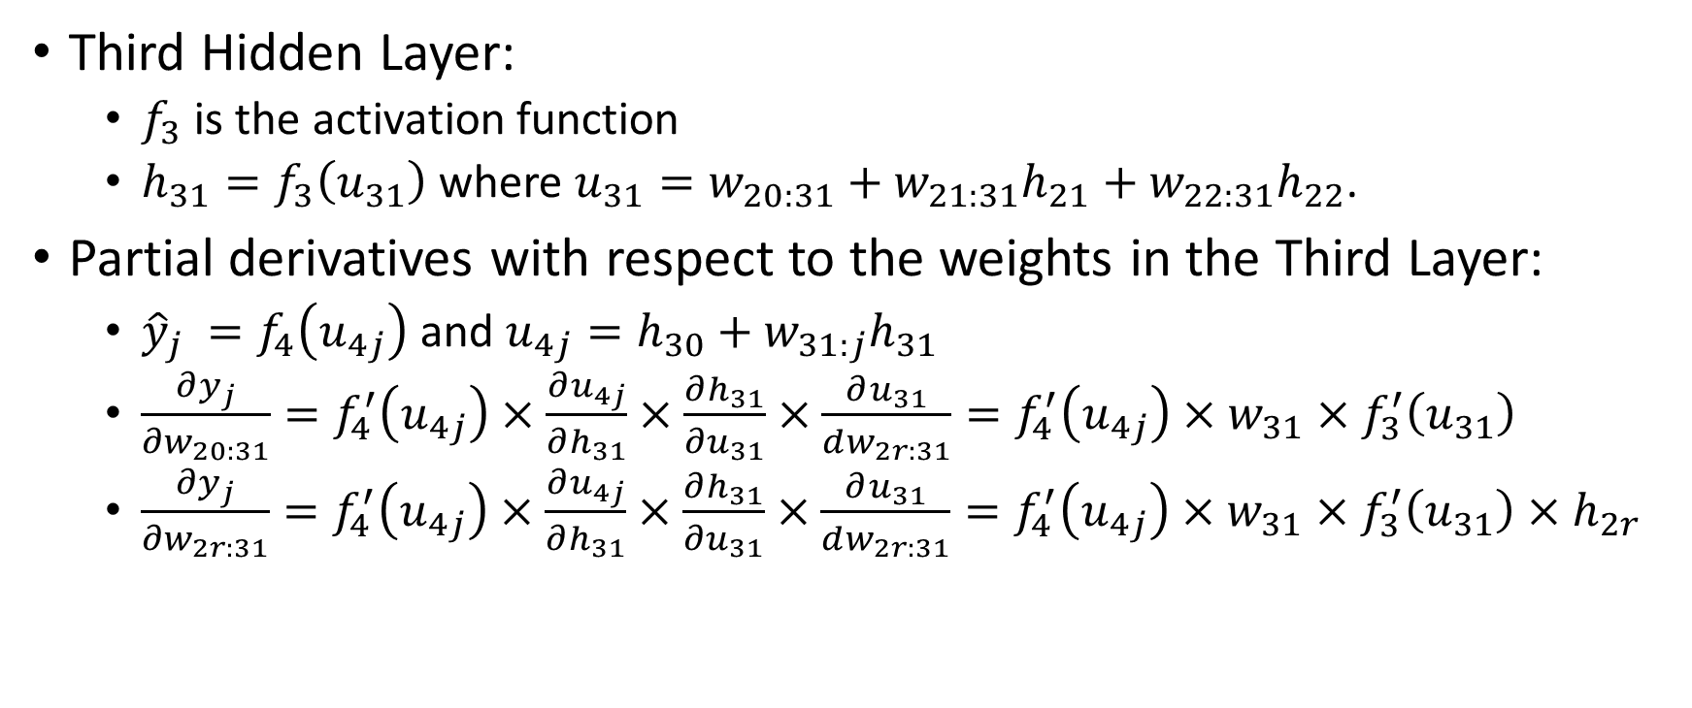
Backpropagation Algorithm Illustration
Third Hidden Layer:
$f_{3}$ is the activation function
$h_{31}=f_{3}\left(u_{31}\right)$ where $u_{31}=w_{20:31}+w_{21:31}h_{21}+w_{22:31}h_{22}$.
Partial derivatives with respect to the weights in the Third Layer:
${\hat{y}}_{j} =f_{4}\left(u_{4j}\right)$ and $u_{4j}=h_{30}+w_{31:j}h_{31}$
$\frac{∂y_{j}}{∂w_{20:31}}=f_{4}^{′}\left(u_{4j}\right)×\frac{∂u_{4j}}{∂h_{31}}×\frac{∂h_{31}}{∂u_{31}}×\frac{∂u_{31}}{dw_{2r:31}}=f_{4}^{′}\left(u_{4j}\right)×w_{31}×f_{3}^{′}\left(u_{31}\right)$
$\frac{∂y_{j}}{∂w_{2r:31}}=f_{4}^{′}\left(u_{4j}\right)×\frac{∂u_{4j}}{∂h_{31}}×\frac{∂h_{31}}{∂u_{31}}×\frac{∂u_{31}}{dw_{2r:31}}=f_{4}^{′}\left(u_{4j}\right)×w_{31}×f_{3}^{′}\left(u_{31}\right)×h_{2r}$

Slide 44
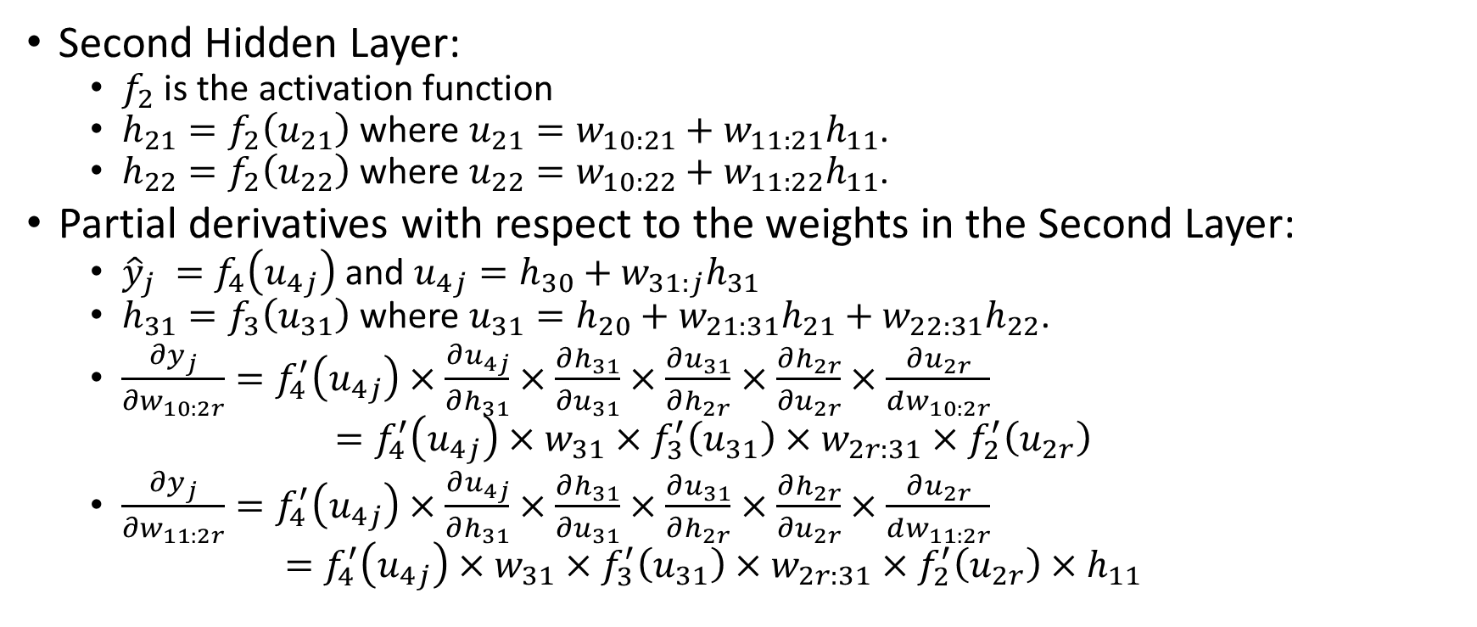
Backpropagation Algorithm Illustration
Second Hidden Layer:
$f_{2}$ is the activation function
$h_{21}=f_{2}\left(u_{21}\right)$ where $u_{21}=w_{10:21}+w_{11:21}h_{11}$.
$h_{22}=f_{2}\left(u_{22}\right)$ where $u_{22}=w_{10:22}+w_{11:22}h_{11}$.
Partial derivatives with respect to the weights in the Second Layer:
${\hat{y}}_{j} =f_{4}\left(u_{4j}\right)$ and $u_{4j}=h_{30}+w_{31:j}h_{31}$
$h_{31}=f_{3}\left(u_{31}\right)$ where $u_{31}=h_{20}+w_{21:31}h_{21}+w_{22:31}h_{22}$.
$\frac{∂y_{j}}{∂w_{10:2r}}=f_{4}^{′}\left(u_{4j}\right)×\frac{∂u_{4j}}{∂h_{31}}×\frac{∂h_{31}}{∂u_{31}}×\frac{∂u_{31}}{∂h_{2r}}×\frac{∂h_{2r}}{∂u_{2r}}×\frac{∂u_{2r}}{dw_{10:2r}}$ $=f_{4}^{′}\left(u_{4j}\right)×w_{31}×f_{3}^{′}\left(u_{31}\right)×w_{2r:31}×f_{2}^{′}\left(u_{2r}\right)$
$\frac{∂y_{j}}{∂w_{11:2r}}=f_{4}^{′}\left(u_{4j}\right)×\frac{∂u_{4j}}{∂h_{31}}×\frac{∂h_{31}}{∂u_{31}}×\frac{∂u_{31}}{∂h_{2r}}×\frac{∂h_{2r}}{∂u_{2r}}×\frac{∂u_{2r}}{dw_{11:2r}}$ $=f_{4}^{′}\left(u_{4j}\right)×w_{31}×f_{3}^{′}\left(u_{31}\right)×w_{2r:31}×f_{2}^{′}\left(u_{2r}\right)×h_{11}$

Slide 45
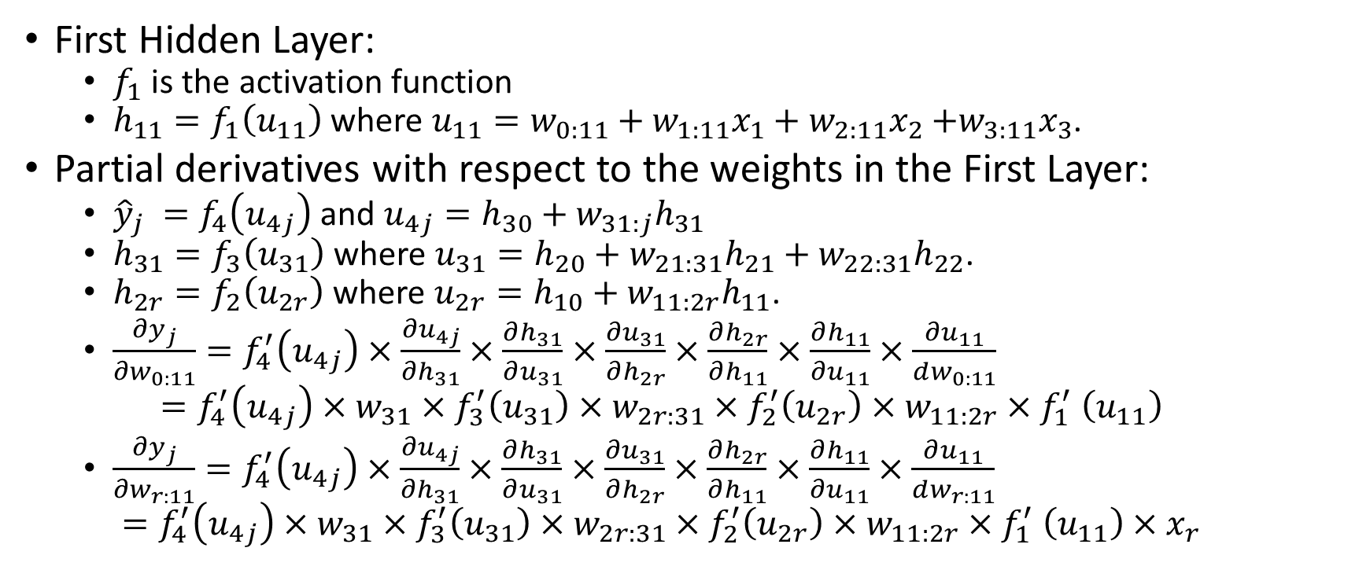
Backpropagation Algorithm Illustration
First Hidden Layer:
$f_{1}$ is the activation function
$h_{11}=f_{1}\left(u_{11}\right)$ where $u_{11}=w_{0:11}+w_{1:11}x_{1}+w_{2:11}x_{2}$ $+w_{3:11}x_{3}$.
Partial derivatives with respect to the weights in the First Layer:
${\hat{y}}_{j} =f_{4}\left(u_{4j}\right)$ and $u_{4j}=h_{30}+w_{31:j}h_{31}$
$h_{31}=f_{3}\left(u_{31}\right)$ where $u_{31}=h_{20}+w_{21:31}h_{21}+w_{22:31}h_{22}$.
$h_{2r}=f_{2}\left(u_{2r}\right)$ where $u_{2r}=h_{10}+w_{11:2r}h_{11}$.
$\frac{∂y_{j}}{∂w_{0:11}}=f_{4}^{′}\left(u_{4j}\right)×\frac{∂u_{4j}}{∂h_{31}}×\frac{∂h_{31}}{∂u_{31}}×\frac{∂u_{31}}{∂h_{2r}}×\frac{∂h_{2r}}{∂h_{11}}×\frac{∂h_{11}}{∂u_{11}}×\frac{∂u_{11}}{dw_{0:11}}$ $=f_{4}^{′}\left(u_{4j}\right)×w_{31}×f_{3}^{′}\left(u_{31}\right)×w_{2r:31}×f_{2}^{′}\left(u_{2r}\right)×w_{11:2r}{×f}_{1}^{′}\left(u_{11}\right)$
$\frac{∂y_{j}}{∂w_{r:11}}=f_{4}^{′}\left(u_{4j}\right)×\frac{∂u_{4j}}{∂h_{31}}×\frac{∂h_{31}}{∂u_{31}}×\frac{∂u_{31}}{∂h_{2r}}×\frac{∂h_{2r}}{∂h_{11}}×\frac{∂h_{11}}{∂u_{11}}×\frac{∂u_{11}}{dw_{r:11}}$ $=f_{4}^{′}\left(u_{4j}\right)×w_{31}×f_{3}^{′}\left(u_{31}\right)×w_{2r:31}×f_{2}^{′}\left(u_{2r}\right)×w_{11:2r}{×f}_{1}^{′}\left(u_{11}\right)×x_{r}$

Slide 46
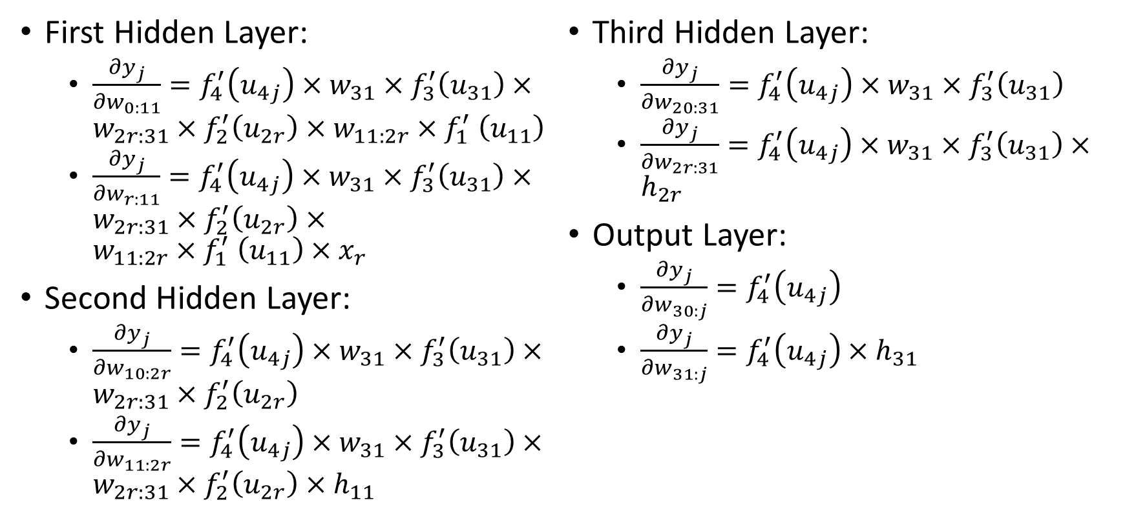
Backpropagation Algorithm Illustration
First Hidden Layer:
$\frac{∂y_{j}}{∂w_{0:11}}=f_{4}^{′}\left(u_{4j}\right)×w_{31}×f_{3}^{′}\left(u_{31}\right)×w_{2r:31}×f_{2}^{′}\left(u_{2r}\right)×w_{11:2r}{×f}_{1}^{′}\left(u_{11}\right)$
$\frac{∂y_{j}}{∂w_{r:11}}=f_{4}^{′}\left(u_{4j}\right)×w_{31}×f_{3}^{′}\left(u_{31}\right)×w_{2r:31}×f_{2}^{′}\left(u_{2r}\right)×w_{11:2r}{×f}_{1}^{′}\left(u_{11}\right)×x_{r}$
Second Hidden Layer:
$\frac{∂y_{j}}{∂w_{10:2r}}=f_{4}^{′}\left(u_{4j}\right)×w_{31}×f_{3}^{′}\left(u_{31}\right)×w_{2r:31}×f_{2}^{′}\left(u_{2r}\right)$
$\frac{∂y_{j}}{∂w_{11:2r}}=f_{4}^{′}\left(u_{4j}\right)×w_{31}×f_{3}^{′}\left(u_{31}\right)×w_{2r:31}×f_{2}^{′}\left(u_{2r}\right)×h_{11}$
Third Hidden Layer:
$\frac{∂y_{j}}{∂w_{20:31}}=f_{4}^{′}\left(u_{4j}\right)×w_{31}×f_{3}^{′}\left(u_{31}\right)$
$\frac{∂y_{j}}{∂w_{2r:31}}=f_{4}^{′}\left(u_{4j}\right)×w_{31}×f_{3}^{′}\left(u_{31}\right)×h_{2r}$
Output Layer:
$\frac{∂y_{j}}{∂w_{30:j}}=f_{4}^{′}\left(u_{4j}\right)$
$\frac{∂y_{j}}{∂w_{31:j}}=f_{4}^{′}\left(u_{4j}\right)×h_{31}$

Slide 47
Backpropagation Algorithm Illustration
The partial derivatives in a layer depend on the
Values of the hidden nodes of the current layer and the subsequent layers
Values of the weights of the subsequent layers.
The algorithm is to update the partial derivatives from the Output Layer, and then work its way back to the First Hidden Layer.

Slide 48
Backpropagation Algorithm Illustration
For current estimates of the weights
Perform a feedforward scoring of the neural network to get the predictions.
Calculate the partial derivatives in the Output Layer, update the weights in that layer using the gradient descent method.
Calculate the partial derivatives in the Third Hidden Layer, update the weights in that layer using the gradient descent method.
Calculate the partial derivatives in the Second Hidden Layer, update the weights in that layer using the gradient descent method.
Calculate the partial derivatives in the First Hidden Layer, update the weights in that layer using the gradient descent method.
Repeat Step 1 to 6 until convergence.

Slide 49
SKLEARN Functions
sklearn.neural_network.MLPClassifier for categorical target variable.
sklearn.neural_network.MLPRegressor for interval target variable.

Slide 50
Office Hours
Instructor, Dr. Lam
mlam5@iit.edu
Mondays / 4 PM to 5 PM / Room 228A, Stuart Building
Except for the Fall Break on October 8
Teaching Assistant, Mr. Jing Zhao
jzhao29@hawk.iit.edu
Thursdays / 2 PM to 3 PM / Room 019A, Stuart Building

